Slide 1
Azure Enterprise Governance & Security Designs
Mohamed Sharaf

Slide 2
READ THIS
This slide deck is *mainly* for:
Architects (Enterprise/Solution/ infra/ dev)
IT Admins
Developer leads
Has some benefit for
Managers / Directors
This slide deck is NOT
Executives
Sales or Marketing material
Operation manual for the *only* way to manage your Microsoft Cloud

Slide 3
Agenda
Subscription Design & management
Resource Groups
Access Control, Billing, and Usage
Subscription governance
Policies & Activity log alert
Azure Networking overview

Slide 4
Subscription Design

Slide 5
Management Portals
Manage access
Manage accounts
Manage subscriptions
View price sheet
View usage summary
Manage usage & lifecycle email notifications
Manage Authentication Types
Account Portal (https://account.windowsazure.com
Enterprise Portal (https://ea.azure.com/
Edit subscription details
Enroll in or enable Preview features
Management Portal (https://manage.windowsazure.com or https://portal.azure.com
Manage co-administrators on subscriptions
Open support tickets for issues within the subscription
Provision/de-provision Azure services
Manage Market place access

Slide 6

Enterprise Azure Roles and Portals
https://ea.windowsazure.com
Enterprise Administrator
Enterprise Enrollment
Department Administrator
Department
Department
https://account.windowsazure.com
Account Owner
Account
Account
Account
https://portal.azure.com
Service Administrator
Subscription
Subscription
Subscription
Subscription
Notes:
To administer your Microsoft Azure services under your Enrollment, there are three distinct administrative roles: the Enterprise Administrator, the Account Owner and the Service Administrator. Users are required to authenticate using a valid Microsoft Account (LiveID http://signup.live.com) or Organizational Account (Cloud-based Active Directory). Make sure the ID entered is associated with a monitored mailbox as enrollment and account notifications will be sent to this mailbox.
The roles complete tasks on three different Microsoft Azure portals. The Enterprise Portal, the Account Portal and the Management Portal.
Enterprise Administrator The Enterprise Administrator has the ability to add or associate Accounts to the Enrollment, can view usage and charges data across all Accounts and Subscriptions, can view the monetary commitment balance associated to the Enrollment. There is no limit to the number of Enterprise Administrators on an Enrollment. You can also add a Notifications Contact that can receive all email notifications. The EA portal is all about billing and usage, enabling the Enterprise Administrator to view billing and usage across all accounts.
Account Owner The Account Owner can add Subscriptions for their Account, update the Service Administrator and Co-Administrator for an individual Subscription, view usage data for their Account, and view Account charges if the Enterprise Administrator has provided access. The Account Owner will not have visibility of the monetary commitment balance unless they also have Enterprise Administrator rights.
Service Administrator The Service Administrator and Co-Administrators per Subscription have the ability to access and manage Subscriptions and development projects within the Azure Management Portal. The Service Administrator does not have access to the Enterprise Portal unless they also have one of the other two roles.

Slide 7
What is an Azure Subscription?
Governs the following:
Billing relationship
Account administration
Role Based Access Control (RBAC) to artifacts
Boundaries/Limits
Boundaries
Usage and billing (rate card based on offer numbers)
Limits
Virtual Network
Attached to 1 AAD (1 AAD be associated with many subscriptions)
Associated to an enterprise enrollment account
Notes:
See https://azure.microsoft.com/en-us/support/legal/offer-details/ for offer codes

Slide 8
Enterprise Dev/Test subscription
Even Better rates for VMs, HDInsight, Cloud Services, and Websites
All usage consumes Azure Monetary Commitment funds
Exclusive Gallery images, like Windows 7 / 8.x / 10 client
Dev/test use only and no SLA
Should be created by a user who has msdn subscription
Can convert a normal subscription to Dev/test subscription

Slide 9
Account Setup Methodology
Functional
Business Division
Geographic
Enterprise
Enterprise
Enterprise
Accounts
Finance
Marketing
Automotive
Life Sciences
North America
Europe
Subscription 1
Subscription 2
Subscription 3
Subscription 4
Subscription 5
Subscription 6
Subscription 7
Subscription 8
Subscription 9
Notes:
Choosing the right account set up methodology for your organization is an important first step in setting up your Accounts. How you set up your Accounts and Subscriptions will impact how they are administered and how they are reflected on your enterprise level reports. This is all done by setting or editing the Account Name field. Examples of typical set up methodologies include structuring by:
Functional Teams - Finance, Marketing, Sales, etc.
Geographic Locations - North America, Europe, Asia, etc.
Business Divisions - Automotive, Aerospace, Medical, etc.
Applications - Application 1, Application 2, etc.

Slide 10
Subscription Considerations
Management approach
Single team or cross-organizational
Role Based Access Control (RBAC)
Security requirements
Data or network security
Environments - Sandbox, Dev, Test, UAT, Pre-Prod, Prod
Connectivity requirements
Single point of ingress?
Multiple regions?
Application requirements
Data flow
Compliance

Slide 11
Subscription Limits (subset)
Azure Resource | Resource Manager API | Service Management API
Cores per subscription | 20/10,000 per region | 20/10,000 Global
Co-administrators per subscription | Unlimited | 200/200 Global, with no RBAC model
Storage accounts per subscription | 100/100 (250 by contacting support) | 100/150 (250 by contacting support)
Managed Disks | 2,000/10,000 | N/A
Cloud Services per subscription | N/A | 20/200
Virtual networks per subscription | 50/500 | 50/100
Local networks per subscription | 10/500 | 20/Contact support
Reserved IPs per subscription | 20/100 | 20/Contact support
Public IP addresses (dynamic) | 60/Contact Support | 400 Global
Reserved public IP addresses | 20/Contact support | 256 Global
Resource Groups per subscription | 800/800 | 500 Global
Virtual machines per subscription | 20/10,000 per region | 50/50 per cloud service
https://azure.microsoft.com/en-us/documentation/articles/azure-subscription-service-limits
Notes:
Updated 06/03/2016
This slide is an eye chart, but it tells an important story: subscriptions have limits. You cannot simply create a single subscription, you need to design according to limits. These limits also differ if you are using the old Azure Management Portal, which uses the Service Management API, or the new portal, which uses the Azure Resource Manager API.
Format is Default/Maximum so 20/200 = 20 default, 200 maximum
aka.ms/azurelimits

Slide 12
Suggested subscription topology
EE
Central IT Department
Central IT Acct
Dev/Test Subscription
Central IT Subscription
Business Unit 01
BU01 Acct
BU01 Subscription
Business Unit 02
BU02 Acct
BU02 Subscription

Slide 13
Subscription Management

Slide 14
How do I manage an Azure Subscription?
Service Manager Roles
Account administrator (create, cancel, billing)
Service administrator (Same as account admin)
Co-Administrator (Can’t change Azure AD, billing, create, etc.)
Account types
Personal (Microsoft Accounts)
Organizational Accounts (Azure AD)
O365/Intune/CRM/EMS
Azure AD created
Can add additional services/subscriptions
As a Partner
Partner manages (On behalf of)
Resource Manager Roles
Role based access via assignment
Partner pays for (service provider model)

Slide 15
How do I mange someone else's subscription?
ARM
Transfer
Add as a co-owner
User Id/app Id in subscription (service administrator)
User id/app Id in resource group
Notes:
https://azure.microsoft.com/en-us/documentation/articles/billing-subscription-transfer/

Slide 16
Subscriptions operations
Each subscription trusts only one Azure AD
Subscriptions in the same Enterprise Enrollment can trust different AD
Change the AD trust
Cancel subscription
Data is retained for 90 days before it’s permanently deleted. Contact support for
Subscriptions can be reactivated during these 90 days and data is restored

Slide 17
Resource Groups
Logical group for Azure resources
Azure portal (portal.azure.com) can only work with Azure Resource Manager APIs
Any resource has to have a resource group
You can deploy and manage resources as one group
Can deploy using programing syntax or declarative syntax

Slide 18
Manage subscriptions using Portal , PowerShell & Azure CLI
Notes:
List subscriptions and select them

Slide 19
Access Control, Billing, and Usage

Slide 20
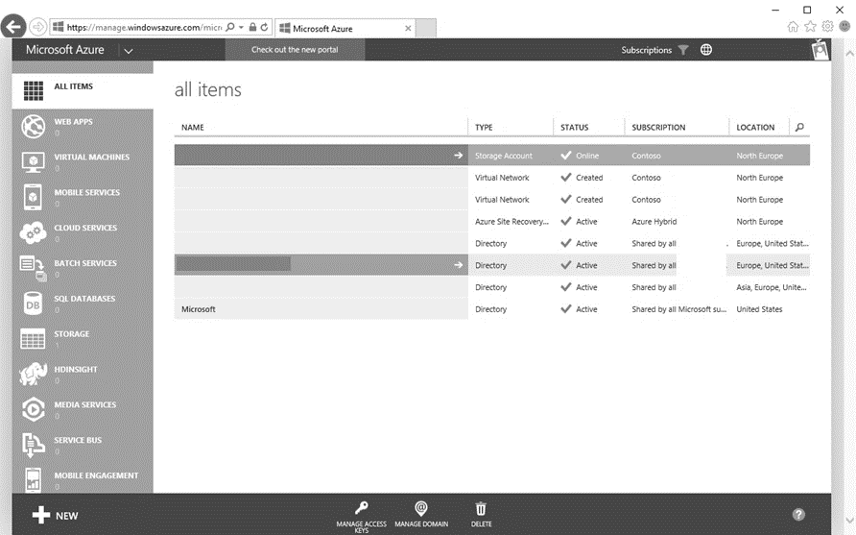
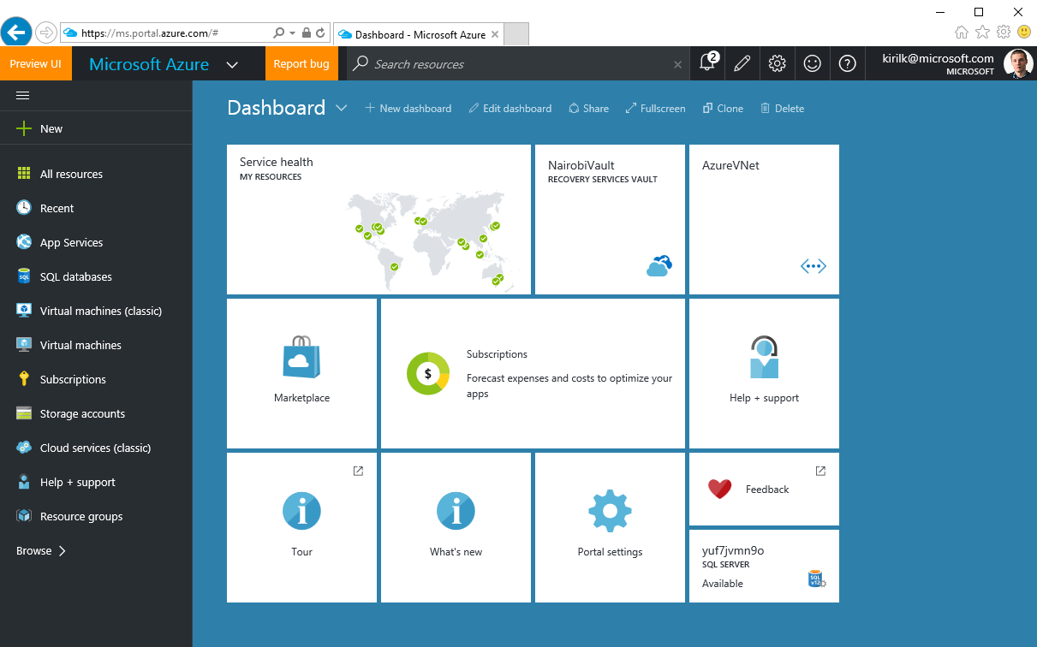
2 generations of Azure
Azure Service Management (ASM)
Azure Resource Manager (ARM)
https://manage.windowsazure.com
No Role Based Access Control
Not available in CSP
https://portal.azure.com
Resource Groups & Tags
Role Based Access Control

Slide 21
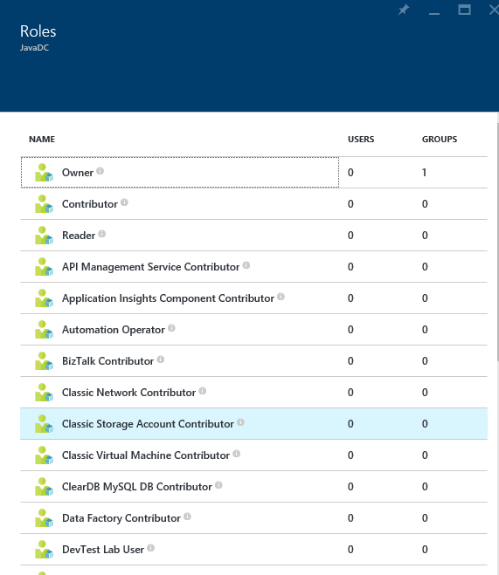
Role Based Access Control (RBAC)
Allows secure access with granular permissions
Assignable to users, groups, or service principals
Built-in roles make it easy to get started
NOTE – RBAC in ARM applies to resources exposed via ARM. Software inside of VMs which may have it’s own security mechanisms and should be considered during design.
Notes:
ARM provides role-based access control, integrating with the Azure Active Directory directory associated with your subscription. This allows you to limit access to resource groups or resources to specific users or groups. There are built-in roles, such as “Virtual Machine Contributor” that lets you manage virtual machines, but not the access to them, and not the virtual networks or storage they are connected to.
It’s important to note RBAC in ARM applies to resources exposed via ARM. Software inside of VMs which may have it’s own security mechanisms and should be considered during design.

Slide 22
Role Based Access Control (RBAC)
Notes:
Access is inherited in the RBAC model. Contributors, owners, and readers assigned at the subscription level have access to the resource groups and resources within that subscription. This can be useful when monitoring all resources deployed to a subscription.
A user assigned as a contributor, owner, or reader of a resource group has access to that resource group and everything contained within it. This can be useful when monitoring a group of resources that comprise an application.
Users and roles can be assigned at the resource level. You might assign a reader for a specific resource so they can see, but not modify, a resource. This can be useful when monitoring a specific resource.

Slide 23
Role Based Access Control (RBAC)
Can get the effective permissions per Subscription, Resource Group or resource
Can get effective permissions per user
Using portal, PS or Azure CLI
48 built-in roles *
All RBAC assignments are tracked in Azure Activity Log
Get-AzureRMAuthorizationChangeLog cmdlet gets the history**
Notes:
* March 2017
** That’s not a builtin command, you have to download it from the PowerShell Gallery

Slide 24
Custom RBAC
Custom roles if the built-in roles are not appropriate
Can be created by PS, CLI or REST API
Can create up to 2000 custom roles per tenant
Can assign operations or exclude operations
Excluded operations are not denying the action.
Assignable scope control to which level or specific subscription/resource group the role can be applied

Slide 25
Custom RBAC
Get-AzureRmProviderOperation shows the operations of Azure Resource Providers
Get-AzureRmRoleDefinition shows the builtin or custom roles definitions
Export a built-in role and then customize it.
New-AzureRmRoleDefinition –InputFile <file>

Slide 26
Mapping teams to RBAC - examples
Teams | Built-in Role | Custom Role
Storage Administrator | Storage Account Contributor
Network Operator |  | Network Contributor - permissions
Network Engineer | Network Contributor
Platform Operator |  | Virtual Machine Contributor - permission
Platform Engineer | Virtual Machine Contributor

Slide 27
RBAC
Notes:
List subscriptions and select them

Slide 28
Resource Tags
Name-value pairs assigned to resources or resource groups
Subscription-wide
Each resource can have up to 15 tags
Name <=512 | Value <=256
No inheritance
Not for Classic (ASM resources)
x15
Notes:
Tags can be applied to resource groups or individual resources, and these tags appear within your usage and billing statement. This enables you to track consumption against individual IO codes, projects, or other taxonomies. You can apply up to 15 tags per resource and resource group. Tags may be placed on a resource at the time of creation or added to an existing resource.

Slide 29
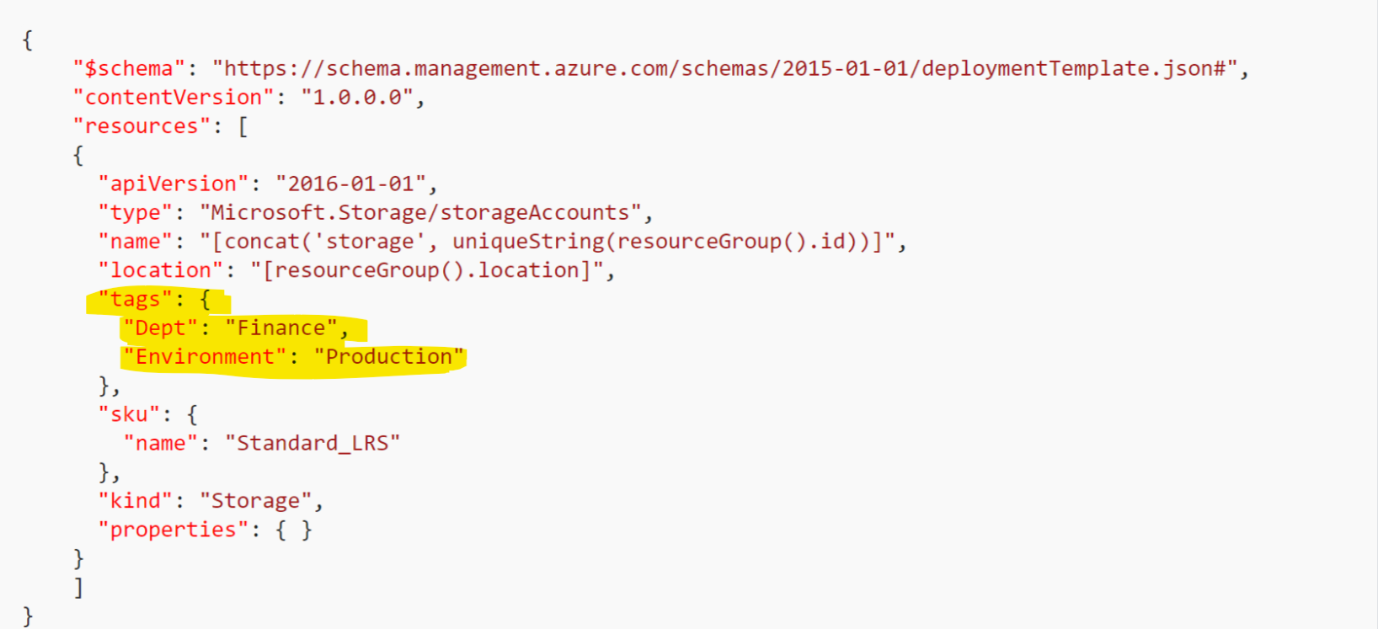
Resource Tags
Tags can by applied in ARM templates, PowerShell, Azure CLI but NOT in the creation wizard in the portal

Slide 30
Tagging Tips
Tag by environment, e.g. dev/test/prod
Tag by role, e.g. web/cache/db
Tag by department, e.g. finance/retail/legal
Tag by responsible party, e.g. Bob
From EA portal, you can get billing excel sheets with the
x15

Slide 31




RateCard API and Usage API
Microsoft Azure
Your Application
Actionable Insights
My workload will cost $368 in Azure
I can save $35 by moving my compute workload from east-us to north-europe
My HR department’s application’s cloud charges were $35 for the past month
RateCard API
(pricing rates)
Pricing insights
Usage API
(usage data)
Usage insights
https://github.com/Azure/BillingCodeSamples
Notes:
Azure Usage API – A REST API that customers and partners can use to get their usage data for an Azure subscription. As part of this new Billing API we now correlate the usage/costs by the resource tags you can now set on your Azure resources (for example: you could assign a tag “Department abc” or “Project X” to a VM or Database in order to better track spend on a resource and charge it back to an internal group within your company). To get more details, please read the MSDN page on the Usage API. Enterprise Agreement (EA) customers can also use this API to get a more granular view into their consumption data, and to complement what they get from the EA Billing CSV.
Azure RateCard API – A REST API that customers and partners can use to get the list of the available resources they can use, along with metadata and price information about them. To get more details, please read the MSDN page on the RateCard API.
Note to speaker: The RateCard API does not currently include EA pricing models during preview.

Slide 32
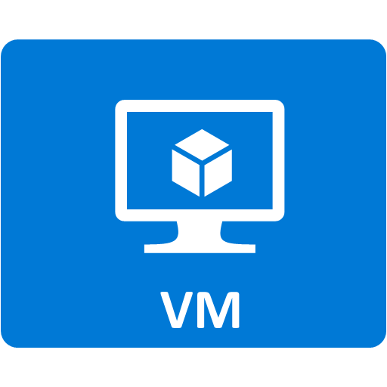
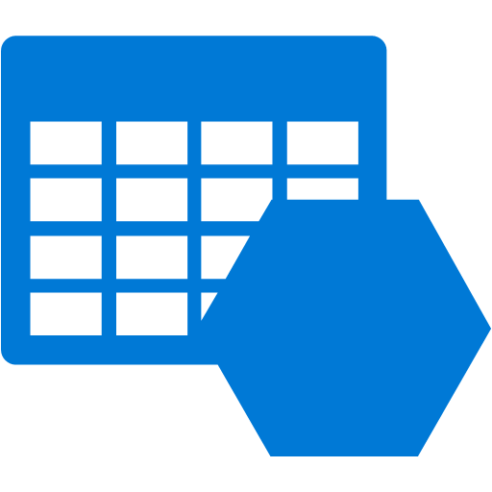


Demo Architecture
Resource Group
IO Code
Virtual Machine Contributor
Availability Set
Machine Type
Machine Type
VM0
VM1
Storage
Virtual Network
Network interface
Network interface
Load balancer
Notes:
The previous demonstration showed how to use a template to provision resources to a resource group. This demonstration will show how to apply tags and role-based access control. We will apply a custom tag, “IO Code”, to the resource group, apply a custom tag “Machine Type” to the virtual machines, and assign the group role “Virtual Machine Contributor” to the resource group.

Slide 33
RBAC and Tagging
Notes:
Find-AzureRmResource -TagName "alwayson"

Slide 34
Azure Resource Manager Policies
Establish conventions
Policy definition
parameters
display name
description
policy rule
logical evaluation
Effect
Policy assignment
Subscription
Resource Group

Slide 35
Azure Resource Manager Policies: Scenarios
Chargeback: Require departmental tags
Geo Compliance: Ensure resource locations
Service Catalogue: Select your service catalog
Convention: Enforce naming & tags
Combine ARM Policies with Activity Log Alerts to cover all requirements

Slide 36
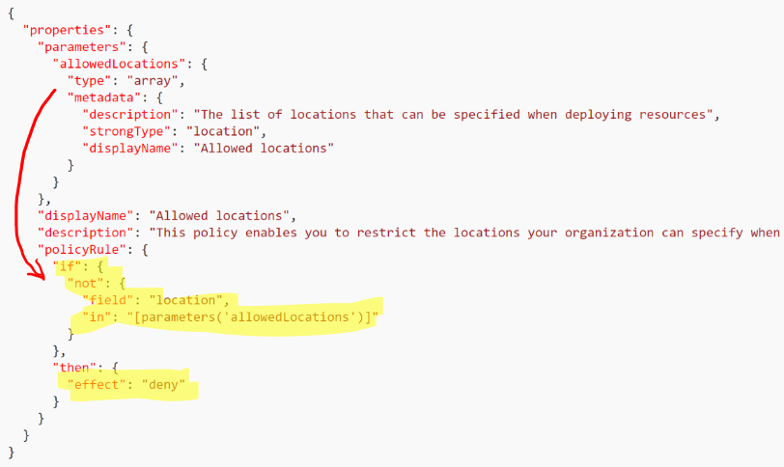
Azure Resource Manager Polices-examples

Slide 37
ARM policies
Notes:
Find-AzureRmResource -TagName "alwayson"

Slide 38
Azure Monitor

Slide 39
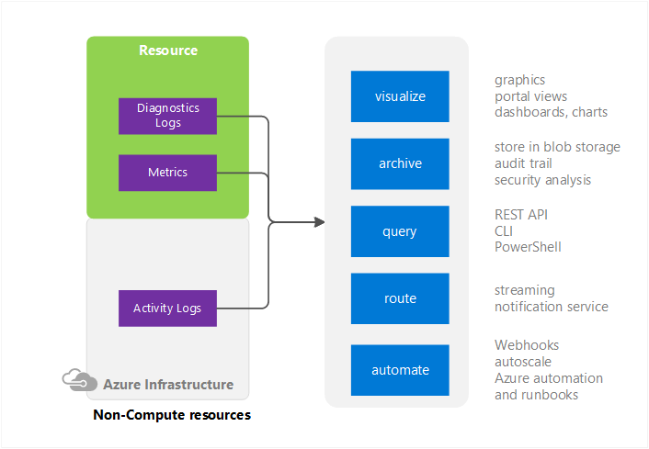
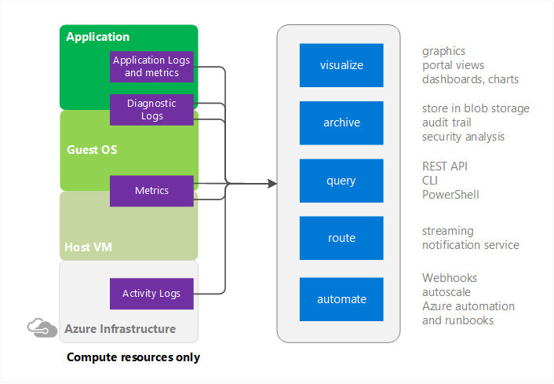
Azure Monitor
One stop built-in monitoring for Azure on multiple levels
Doesn’t use a separate agent

Slide 40
Azure Monitor
Has many sources
Activity log
Diagnostics logs, Application logs and Matrices
Performance counters
Application Logs
Windows Event Logs
.NET Event Source
IIS Logs
Manifest based ETW
Crash Dumps
Customer Error Logs
Integrate with Log Analytics, Event Hubs & storage accounts

Slide 41
Azure Monitor
Can create alerts based on matrices or Activity Log
Alerts delver immediate SMS/email or webhook
Activity log alerts use cases
When creating certain type of resoruces
When Altering the state of important resources
When important resource restarts or change its operation state
When permissions are granted to users/groups

Slide 42
Naming Conventions in Azure

Slide 43
Naming Conventions
Importance
Places the naming pattern in an order that allows easier application level grouping for potential showback/chargeback billing.
Automation.
Consideration
Some resource names are:
Requirements
Ensure:
Constrained by length.
Constrained to alpha-numeric.
Constrained unique within account
Cannot contain offensive or forbidden substrings.
Case sensitivity requirements
Application association
Environment association
Region association
Instance association
Object association
Describes type of resource in the subscription.
Unique Azure naming
Constrained unique across entire Azure.
Cannot include upper case characters.

Slide 44
Azure Naming Constraints Examples
Some resource names are constrained-Must be globally unique across Azure
e.g., SQL Server Name, Storage Account Names, etc.
Some resource names are constrained by length
e.g., Search Service is constrained 2 to 15 characters
Some resource names are constrained to alpha-numeric
e.g., Storage Account Name cannot have dash, dots, etc.
Some resource names must be unique within the subscription
e.g., Storage Table Name must be unique within Azure storage account
Some resource names cannot be upper characters
e.g., Storage account names must be all lower case

Slide 45
Subscription Governance summary

Slide 46
Subscription Design Guidance (General)
Work or School Accounts not Microsoft Accounts
Use organizational accounts to sign-up and manage Azure. Connect your Azure AD with on-prem AD.
Resource Groups not Subscriptions
Use resource groups to segregate workloads with different access needs. Avoid granting access to individual resources unless necessary.
Manage Access using Groups
Assign access to AD groups, manage membership of groups for on-going access management.
Enable Multi-Factor Auth
Use Azure AD conditional access policies to enable MFA for Azure management.
Least Privilege
Pick the right role for the job. Contributor not Owner. Model on-premises roles using resource-type specific Azure roles.

Slide 47
Subscription Design Guidance (General)
Keep a tab on Access Changes
Monitor changes to access settings. Regularly dump and review entire access policy.
Control # of subscriptions. Start with 3 (1 Business Unite/function, 1 IT, 1 Dev)
Identity Management
Use Customer Azure Active Directory for Azure Governance roles
Add at least one more Enterprise Administrator
Use Functional Accounts not Named Accounts for Roles. Specially for Account Owners and Service Administrators
Security and Identity
If the subscription includes Azure Active Directory, IaaS Domain Controllers, or connects to Domain Controllers from an on-premises active directory, the Subscription administrators and Co-administrators are de-facto domain owners as well.
Scale
Subscriptions form the scale unit in Azure. Many resources, from computing cores, and storage accounts, to reserved IP addresses all have quantity and size limitations based on the subscription.

Slide 48
Subscription Design Guidance (Networking)
Connectivity
The subscription is a required container to hold a virtual network, and oftentimes networking is a shared resource within an enterprise
VLANs do NOT span subscriptions
Express Route
Minimize #subscriptions (take network requirements and ER boundaries into account)
10 virtual networks can be attached to a single ExpressRoute standard circuit, so at most 10 subscriptions could be attached to that circuit (Premium varies from 20-100)
Notes:
https://azure.microsoft.com/en-us/documentation/articles/azure-subscription-service-limits/#limits-and-the-azure-resource-manager

Slide 49
Network Isolation

Slide 50
Virtual Network
Isolated, logical network providing connectivity for Azure Virtual Machines
User-defined address space (can be one or more IP ranges, not necessarily RFC1918)
1. Connectivity for VMs in the same VNet
2. Connectivity to external networks/on-prem DC’s
3. Internet connectivity
(outbound allowed by default, inbound blocked)
Internet
3. Internet
Name: VNet1
Address space: 10.57.0.0/16, 10.66.0.0/24
2. On Prem
VM
1. Intra-VNET
VM

Slide 51
Subnet (think of a VLAN)
IP subnet
Provides full layer-3 semantics and partial layer-2 semantics (DHCP, ARP, no broadcast/multicast)
Subnets can span only one range of contigous IP addresses
VMs can be deployed only to subnets (not VNets)
Name: VNet1
Address space: 10.57.0.0/16, 10.66.0.0/24
Subnet1
10.57.1.0/24
Subnet2
10.66.0.0/24
VM1
VM3
VM4
VM5
VM2
VM6
VM7

Slide 52
Network Interface
Virtual NIC connects VMs to Subnets
One or more private IP address (private ➔ in the subnet’s IP range, not necessarily RFC1918)
Private IP address always assigned via Azure DHCP
Attached to Subnet
Dynamic assignment ➔
DHCP assigns new IP when VM is restarted
Static assignment ➔
DHCP assigns always the same IP
IP forwarding ➔
Required for Network Virtual Appliance use cases
Public IP ➔ NAT address associated to the NIC (more on this later). AKA «VIP»
Virtual machine
Private IP
«DIP»
NIC
Assignment=static/dynamic
IP Forwarding=yes/no
Public IP=<public IP>
IpConfiguration

Slide 53

Switching/Routing in Azure VNets
A VNet provides a switching/routing functionality that allows VMs to talk to each other
Name: VNet2
Address space: 10.57.0.0/16
Please note that, in an Azure VNet, packets can flow between to different subnets without explicitly traversing any layer-3 device. Azure’s network virtualization stack effectively works as a layer-3 switch
Subnet1
10.57.1.0/24
Subnet2
10.57.2.0/25
VM1
VM4
VM3
VM5
VM2
VM6
Switch/Routing
(Azure VM Switch)

Slide 54
Network Security Groups (NSGs)
List of port-based security rules
Assigned to subnets or NIC

Slide 55
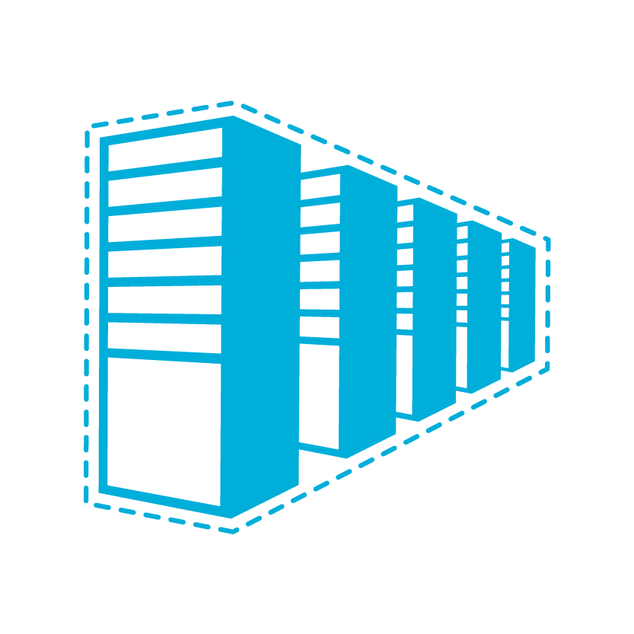
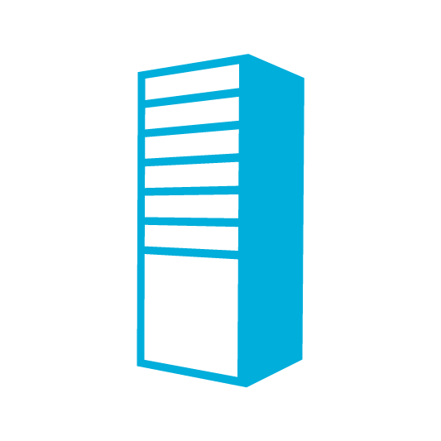

Azure Connectivity Options and Hybrid Offerings
Cloud
Customer
Segment and workloads
Consumers
Access over public IP
DNS resolution
Connect from anywhere
Internet Connectivity
Developers
POC Efforts
Small scale deployments
Connect from anywhere
Secure point-to-site connectivity
SMB, Enterprises
Connect to Azure compute
Secure site-to-site
VPN connectivity
SMB & Enterprises
Mission critical workloads
Backup/DR, media, HPC
Connect to all Azure services
ExpressRoute private connectivity

Slide 56
Virtual Network Gateway
Virtual layer-3 device that routes traffic to remote networks
Name: VNet1
Address space: 10.57.0.0/16
Virtual device attached to an Azure VNet (similar to VMs)
Always provisioned in a reserved subnet named «GatewaySubnet»
Highly available service
The «GatewaySubnet» is part of the VNet‘s address space (/27 or bigger)
Each Gateway is associated to a public IP address (via Azure Load Balancer)
Two types of Gateways (VPN & Express Route) and you can have both
Subnet1
10.57.1.0/24
Subnet2
10.57.2.0/25
GatewaySubnet
10.57.3.0/27
VM1
VM4
Virtual Network Gateway
VM3
VM5
VM2
VM6
Switch/router (Azure VM Switch)

Slide 57
ExpressRoute is dedicated connectivity…
Internet
Customer Network
Microsoft Network
ExpressRoute
Customer Datacenter
Office 365 Datacenter
Azure
Datacenter
Azure
Datacenter

Slide 58
Azure Intra-Cloud Connectivity Options
Cloud
Typical Scenario
Used to connect VNets in multiple Azure Regions
Supports transit routing with BGP-enabled VPNs
VNet to VNet via VPN
Combined with VPN and ExpressRoute for transit VNet
Peering within a region
“wire speed” throughput
Virtual Network Peering
ExpressRoute connectivity allows for VNet to VNet connectivity over the Microsoft Backbone
VNet to VNet via ExpressRoute

Slide 59
VNet to VNet via VPN
VNets can be connected with each other via IPSec tunnels
Name: VNet3
Address space: 10.57.0.0/16
Name: VNet4
Address space: 10.6.0.0/16
Subnet1
10.57.1.0/24
Gateway Subnet
10.57.3.0/27
Gateway Subnet
10.6.3.0/27
Subnet1
10.6.11.0/24
VM1
VM3
VM1
VM3
VPN
VNet-2-VNet
VPN
VM2
VM2

Slide 60
VNet to VNet via VPN
How a VNet-2-VNet connection is reflected in the route table
Name: VNet3
Address space: 10.57.0.0/16
Name: VNet4
Address space: 10.6.0.0/16
Subnet1
10.57.1.0/24
Gateway Subnet
10.57.3.0/27
Gateway Subnet
10.6.3.0/27
Subnet1
10.6.11.0/24
VM1
VM3
VM1
VM3
VPN
VPN
VM2
VM2
System Route Table: VNet3
Dest: 10.57.0.0/16 | Send to: Local VNet
Dest: 0.0.0.0/0 | Send to: Internet
System Route Table: VNet4
Dest: 10.6.0.0/16 | Send to: Local VNet
Dest: 0.0.0.0/0 | Send to: Internet

Slide 61
VNet to VNet via VPN
How a VNet-2-VNet connection is reflected in the route table
Name: VNet3
Address space: 10.57.0.0/16
Name: VNet4
Address space: 10.6.0.0/16
Subnet1
10.57.1.0/24
Gateway Subnet
10.57.3.0/27
Gateway Subnet
10.6.3.0/27
Subnet1
10.6.11.0/24
VM1
VM3
VM1
VM3
VPN
VNet-2-VNet
VPN
VM2
VM2
System Route Table: VNet3
Dest: 10.57.0.0/16 | Send to: Local VNet
Dest: 0.0.0.0/0 | Send to: Internet
System Route Table: VNet4
Dest: 10.6.0.0/16 | Send to: Local VNet
Dest: 10.57.0.0/16 | Send to: VNet Gateway
Dest: 0.0.0.0/0 | Send to: Internet

Slide 62
VNet to VNet via VPN
How a VNet-2-VNet connection is reflected in the route table
Name: VNet3
Address space: 10.57.0.0/16
Name: VNet4
Address space: 10.6.0.0/16
Subnet1
10.57.1.0/24
Gateway Subnet
10.57.3.0/27
Gateway Subnet
10.6.3.0/27
Subnet1
10.6.11.0/24
VM1
VM3
VM1
VM3
VPN
VNet-2-VNet
VPN
VM2
VM2
System Route Table: VNet3
Dest: 10.57.0.0/16 | Send to: Local VNet
Dest: 10.6.0.0/16 | Send to: VNet Gateway
Dest: 0.0.0.0/0 | Send to: Internet
System Route Table: VNet4
Dest: 10.6.0.0/16 | Send to: Local VNet
Dest: 10.57.0.0/16 | Send to: VNet Gateway
Dest: 0.0.0.0/0 | Send to: Internet

Slide 63
VNet to VNet via VPN
Routing with multiple VNet-2-VNet connections
Name: VNet4
Address space: 10.6.0.0/16
System Route Table: VNet4
Dest: 10.6.0.0/16 | Send to: Local VNet
Dest: 10.57.0.0/16 | Send to: VNet GW
Dest: 0.0.0.0/0 | Send to: Internet
Gateway Subnet
10.6.3.0/27
Subnet1
10.6.11.0/24
Name: VNet3
Address space: 10.57.0.0/16
VM1
VM3
System Route Table: VNet3
Dest: 10.57.0.0/16 | Send to: Local VNet
Dest: 10.6.0.0/16 | Send to: VNet GW
Dest: 10.7.0.0/16 | Send to: VNet GW
Dest: 0.0.0.0/0 | Send to: Internet
VPN
VM2
Subnet1
10.57.1.0/24
Gateway Subnet
10.57.3.0/27
VNet-2-VNet
VM1
VM3
VPN
Name: VNet5
Address space: 10.7.0.0/16
VM2
System Route Table: VNet5
Dest: 10.7.0.0/16 | Send to: Local VNet
Dest: 10.57.0.0/16 | Send to: VNet GW
Dest: 0.0.0.0/0 | Send to: Internet
VNet-2-VNet
Gateway Subnet
10.7.3.0/27
Subnet1
10.7.8.0/24
No transit routing: VNet4 and VNet5 do not have routes in their tables to send traffic to each other!!
VM1
VM3
VPN
VM2

Slide 64
VNet to VNet via VPN
How to achieve any-to-any connectivity?
Name: VNet4
Address space: 10.6.0.0/16
Gateway Subnet
10.6.3.0/27
Subnet1
10.6.11.0/24
Name: VNet3
Address space: 10.57.0.0/16
VM1
VM3
VPN
VM2
Subnet1
10.57.1.0/24
Gateway Subnet
10.57.3.0/27
VNet-2-VNet
VM1
VM3
VPN
Name: VNet5
Address space: 10.7.0.0/16
VM2
VNet-2-VNet
Gateway Subnet
10.7.3.0/27
Subnet1
10.7.8.0/24
VM1
VM3
VPN
VM2

Slide 65
VNet to VNet via VPN
How to achieve any-to-any connectivity?
Name: VNet4
Address space: 10.6.0.0/16
Gateway Subnet
10.6.3.0/27
Subnet1
10.6.11.0/24
Name: VNet3
Address space: 10.57.0.0/16
VM1
VM3
VPN
VM2
Subnet1
10.57.1.0/24
Gateway Subnet
10.57.3.0/27
VNet-2-VNet
Option #1: full mesh topology (each VNet is directly connected to any other VNet)
VM1
VM3
VNet-2-VNet
VPN
Name: VNet5
Address space: 10.7.0.0/16
VM2
VNet-2-VNet
Gateway Subnet
10.7.3.0/27
Subnet1
10.7.8.0/24
VM1
VM3
VPN
VM2

Slide 66
VNet to VNet via VPN
How to achieve any-to-any connectivity?
Name: VNet4
Address space: 10.6.0.0/16
Gateway Subnet
10.6.3.0/27
Subnet1
10.6.11.0/24
Name: VNet3
Address space: 10.57.0.0/16
VM1
VM3
VPN
BGP
VM2
Subnet1
10.57.1.0/24
Gateway Subnet
10.57.3.0/27
VNet-2-VNet
Option #2: leverage BGP support
VM1
VM3
VPN
Name: VNet5
Address space: 10.7.0.0/16
VM2
BGP
VNet-2-VNet
Gateway Subnet
10.7.3.0/27
Subnet1
10.7.8.0/24
VM1
VM3
VPN
BGP
VM2

Slide 67
VNet to VNet via VPN
How to achieve any-to-any connectivity?
Name: VNet4
Address space: 10.6.0.0/16
System Route Table: VNet4
Dest: 10.6.0.0/16 | Send to: Local VNet
Dest: 10.57.0.0/16 | Send to: VNet GW
Dest: 10.7.0.0/16 | Send to VNet GW
Dest: 0.0.0.0/0 | Send to: Internet
Gateway Subnet
10.6.3.0/27
Subnet1
10.6.11.0/24
Name: VNet3
Address space: 10.57.0.0/16
VM1
VM3
VPN
BGP
VM2
Subnet1
10.57.1.0/24
Gateway Subnet
10.57.3.0/27
VNet-2-VNet
VM1
VM3
VPN
Name: VNet5
Address space: 10.7.0.0/16
VNet4 has now a route to send traffic to VNet5. VNet3 acts as a tranist network
VM2
BGP
VNet-2-VNet
Gateway Subnet
10.7.3.0/27
Subnet1
10.7.8.0/24
VM1
VM3
VPN
BGP
VM2

Slide 68
VNet to VNet via VPN
How to achieve any-to-any connectivity?
Option#1: Full Mesh | Option#2: BGP + transit routing
Efficient routing: each VNet is directly connected to any other VNet | Traffic between VNets may cross 1 or more transit networks
Many VNet-2-VNet connections to be maintained | Any-to-any connectivity is possible with fewer VNET-2VNET connections
Cross-VNET communication performance is capped by VNet Gateway’s bandwidth | Cross-VNET communication performance is capped by VNet Gateway’s bandwidth

Slide 69

VNet to VNet via VPN
How to achieve any-to-any connectivity?
Option#1: Full Mesh | Option#2: BGP + transit routing
Efficient routing: each VNet is directly connected to any other VNet | Traffic between VNets may cross 1 or more transit networks
Many VNet-2-VNet connections to be maintained | Any-to-any connectivity is possible with fewer VNET-2VNET connections
Cross-VNET communication performance is capped by VNet Gateway’s bandwidth | Cross-VNET communication performance is capped by VNet Gateway’s bandwidth
Both options limitations: VNet peering addresses them by pushing the complexity of connecting VNet into Azure’s network stack!

Slide 70
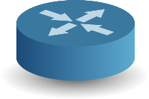
VNet to VNet via ExpressRoute
VNets can be connected with each other via an ExpressRoute circuit (via IP tunnels)
Name: VNet3
Address space: 10.57.0.0/16
Name: VNet4
Address space: 10.6.0.0/16
Microsoft Backbone Network
Subnet1
10.57.1.0/24
Gateway Subnet
10.57.3.0/27
Gateway Subnet
10.6.3.0/27
Subnet1
10.6.11.0/24
VM1
ExpressRoute
ExpressRoute
VM1
VM3
VM3
ER
ER
ExpressRoute
VM2
VM2
Customer Network (P2P Ethernet, Fiber, MPLS/IPVPN)

Slide 71
VNet to VNet via ExpressRoute
Name: VNet3
Address space: 10.57.0.0/16
Name: VNet4
Address space: 10.6.0.0/16
Microsoft Backbone Network
Subnet1
10.57.1.0/24
Gateway Subnet
10.57.3.0/27
Gateway Subnet
10.6.3.0/27
Subnet1
10.6.11.0/24
VM1
ExpressRoute
ExpressRoute
VM1
VM3
VM3
ER
ER
ExpressRoute
VM2
VM2
System Route Table: VNet3
Dest: 10.57.0.0/16 | Send to: Local VNet
Dest: 0.0.0.0/0 | Send to: Internet
Customer Network (P2P Ethernet, Fiber, MPLS/IPVPN)
System Route Table: VNet4
Dest: 10.6.0.0/16 | Send to: Local VNet
Dest: 0.0.0.0/0 | Send to: Internet

Slide 72
VNet to VNet via ExpressRoute
How to have multiple VNet connections (up to 10/100)
Name: VNet3
Address space: 10.57.0.0/16
Name: VNet4
Address space: 10.6.0.0/16
Name: VNet5
Address space: 10.7.0.0/16
Subnet1
10.57.1.0/24
Gateway Subnet
10.57.3.0/27
Gateway Subnet
10.6.3.0/27
Subnet1
10.6.11.0/24
Gateway Subnet
10.7.3.0/27
Subnet1
10.7.8.0/24
VM1
VM3
VM1
VM3
VM1
VM3
ER
ER
ER
VM2
VM2
VM2
ER Connection
ER Connection
ER Connection
Customer Network (P2P Ethernet, Fiber, MPLS/IPVPN)
Microsoft Backbone Network
ExpressRoute CIrcuit

Slide 73
What is VNet peering?
Ability to “merge” two Azure VNets, so that VMs in the two VNets can communicate with each other as if they were on the same VNet
VNet1
VNet2
Subnet1
Subnet2
Subnet1
Subnet2
VM1
VM4
VM1
VM3
VM4
VM3
VM5
VM5
VM2
VM6
VM2
VM6
Switch/Routing
Switch/Routing

Slide 74
What is VNet peering?
Ability to “merge” two Azure VNets, so that VMs in the two VNets can communicate with each other as if they were on the same VNet
VNet1
VNet2
Subnet1
Subnet2
Subnet1
Subnet2
VM1
VM3
VM4
VM1
VM3
VM4
VM5
VM5
VM2
VM6
VM2
VM6
Switch/Routing

Slide 75
VNet peering key facts
Traffic across peering VNets is managed in a very similar way to intra-VNet traffic
Works for VNets in the same region
Provides the same performance as intra-VNet traffic
Works across subscriptions (if subscriptions are under the same Azure AD Tenant)
At least one of the two VNets must be ARM

Slide 76
VNet peering is non-transitive
VNet1
VNet2
VNET3
Peering
Peering
VNet1 can send/receive traffic to/from VNet2
VNet2 can send/receive traffic to/from VNet1, VNet3
VNet3 can send/receive traffic to/from VNet2
VNet1 cannot send/receive traffic to/from VNet3 unless there is a routing appliance in VNet 2 to handle inter-VNet traffic (see Hub & Spoke topology)

Slide 77
VNet peering topology : Hub & Spoke
HR VNet
Peering
All VNets can communicate with the Hub VNet, but HR, Marketing and Engineering cannot natively* “talk” to each other
*see transit VNet slide
Marketing VNet
Hub site
(shared services)
Peering
Peering
Engineering
VNet

Slide 78
VNet peering topology : partial mesh
HR VNet
Peering
Marketing VNet
Hub site
(shared services)
Peering
Peering
Peering
Engineering
VNet

Slide 79
VNet peering topology : full mesh
HR VNet
Peering
Peering
Marketing VNet
Hub site
(shared services)
Peering
Peering
Peering
Engineering
VNet

Slide 80
Gateway transit
A VNet’s ability to route traffic which has not been originated in it and is not destined to it
VNet1
VNet2
Peering
Virtual Network Gateway
IPSec or ER
On-Premises
VM A
VNet1 and VNet2 must be both ARM!

Slide 81
Network Virtual Appliances (aka NFV)
VMs implementing network functions virtualization
Firewall
Application firewall
IDS/IPS
Load Balancer
VPN Devices
WAN Acceleration (SD-WAN)
Routing
You must plan for HA for NVAs
Azure features that enable NVA scenarios
IP Forwarding & UDRs

Slide 82
Resources
Design for subscription boundaries
Billing and Usage APIs
Azure Resource Manager provides RBAC, tagging, organization, and deployment
Samples - https://github.com/Azure/azure-quickstart-templates
Documentation - http://azure.microsoft.com/en-us/documentation/articles/resource-group-overview/

Slide 83
Resources
Best practices for enterprises moving to Azure | Microsoft Docs
https://docs.microsoft.com/en-us/azure/azure-resource-manager/resource-manager-subscription-governance

